Slide 1

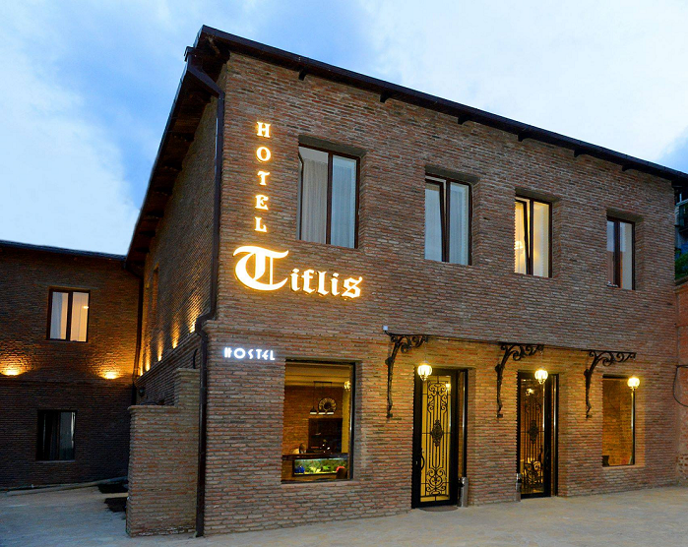
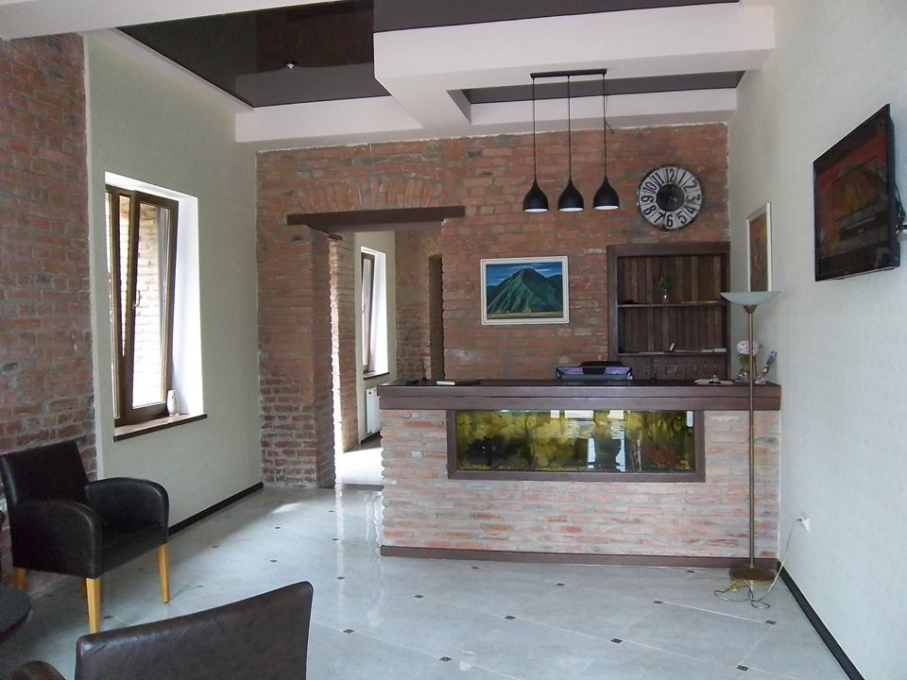
Hotel Tiflis
Warmly
Welcomes You

Slide 2

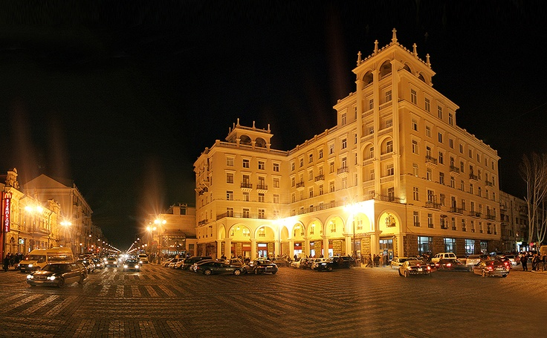
The new “Tiflis-Hotel” in Tbilisi centre is an exclusive international 3-star hotel
Located on Marjanishvili str 25, the heart of downtown’s busting touristic and shopping district..

Slide 3
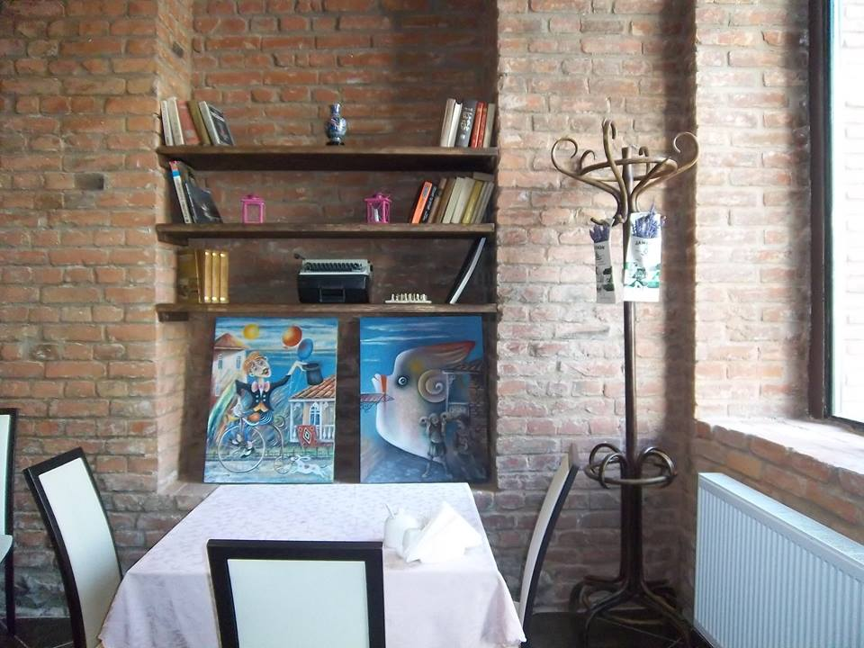
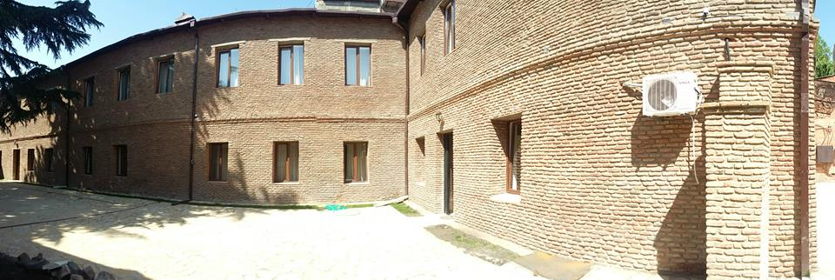
The hotel combines 20 well appointed guest rooms
The Calmes place inside of the busiest part of the city.
Complimentary WI-FI and international call service are on offer
“Hotel-Tiflis offer personalized service and additional privacy for the needs of today’s busy executes

Slide 4

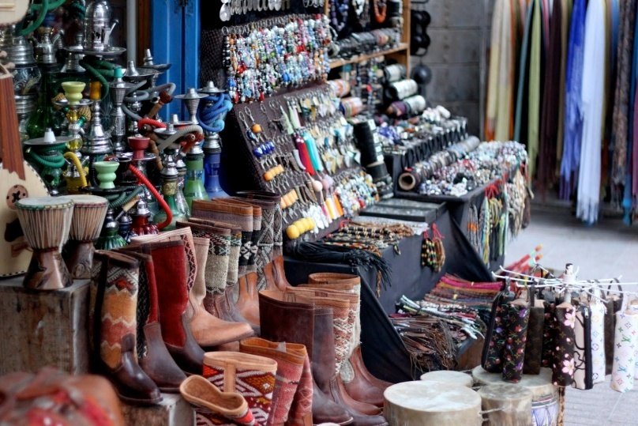
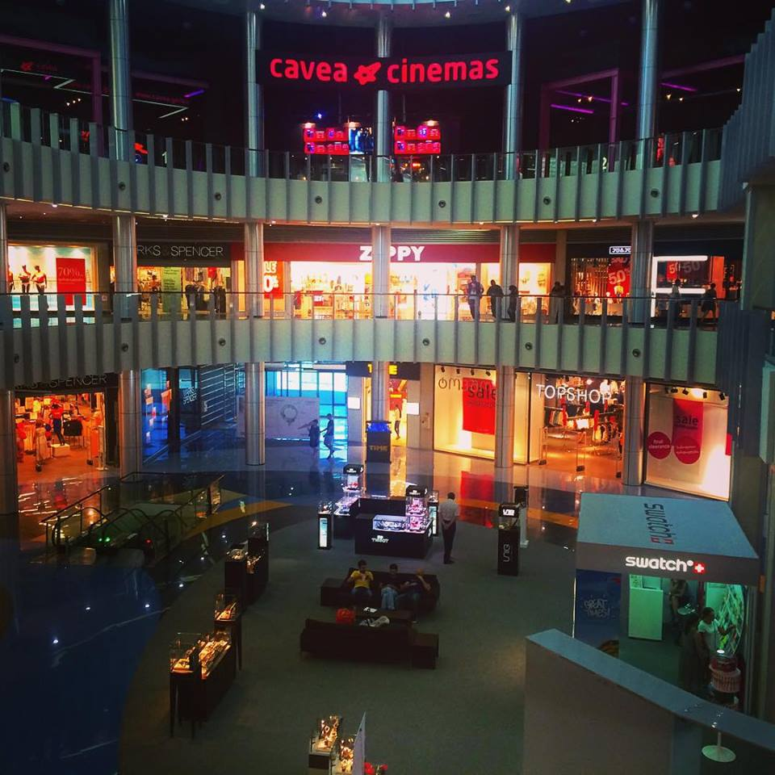
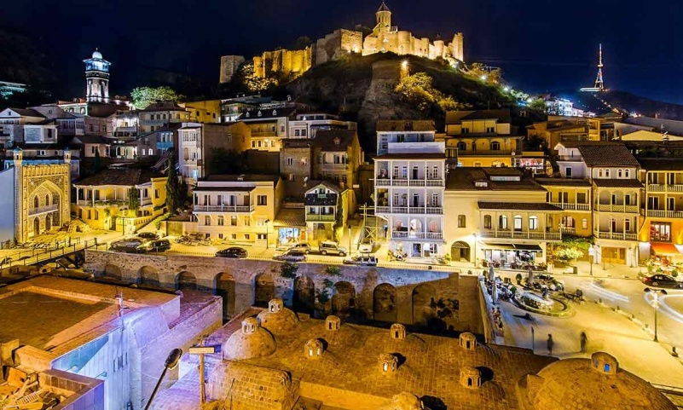
Nearest destinations from our hotel:
Metro Station – 2 minutes by foot
McDonalds – 3 minutes by foot
Rustaveli ave. (main street of Tbilisi) - 5 min by Car
Flea Market – 5 min by Car
Tbilisi Shopping Mall - 20 min by Car
Old Tbilisi – 7 min by Car

Slide 5
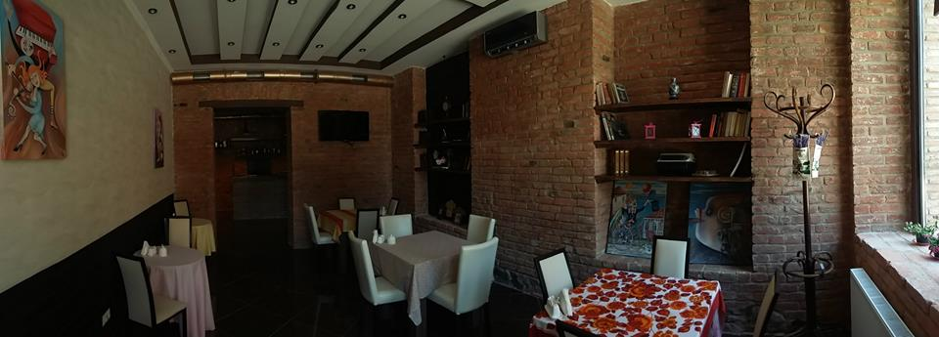
Hotel Facilities :
Highest Quality
Largest variety
Consistent professionalism
Restaurant for functions and breakfast
Café & Bar
FreeWi-Fi
Wheelchair-accessible hotel & Friendly Atmosphere

Slide 6
Hotel/Hostel Tiflis Reception Desk

Slide 7
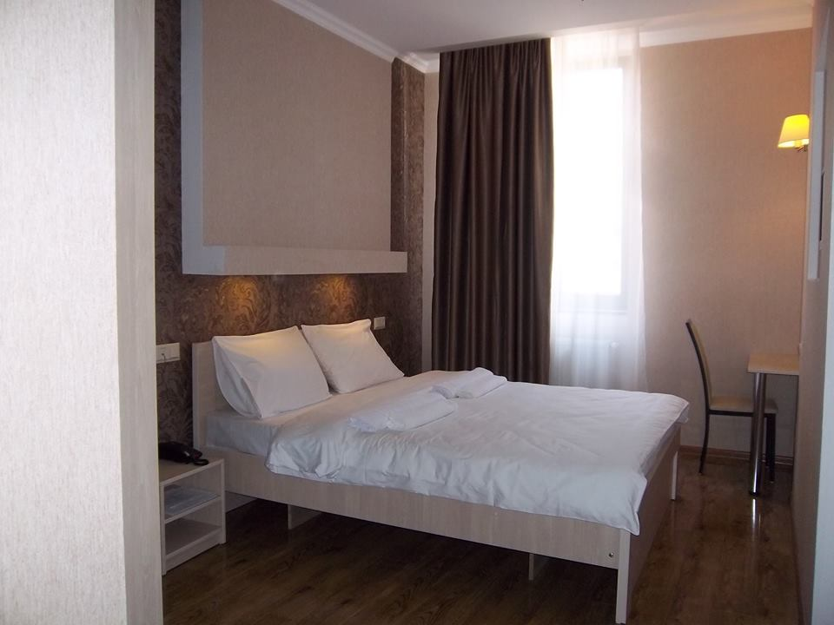
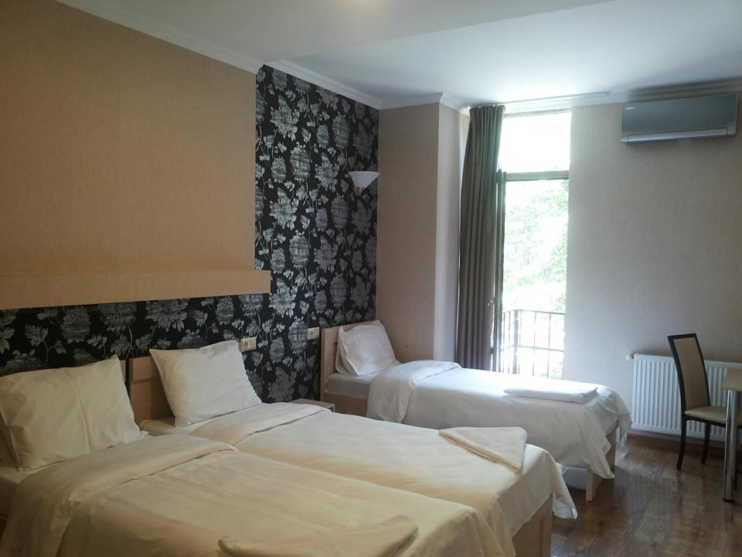
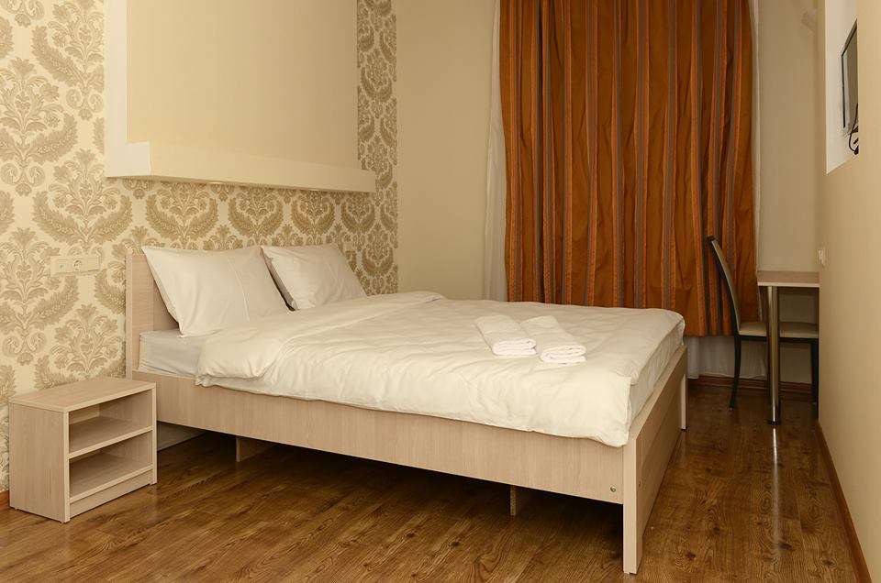
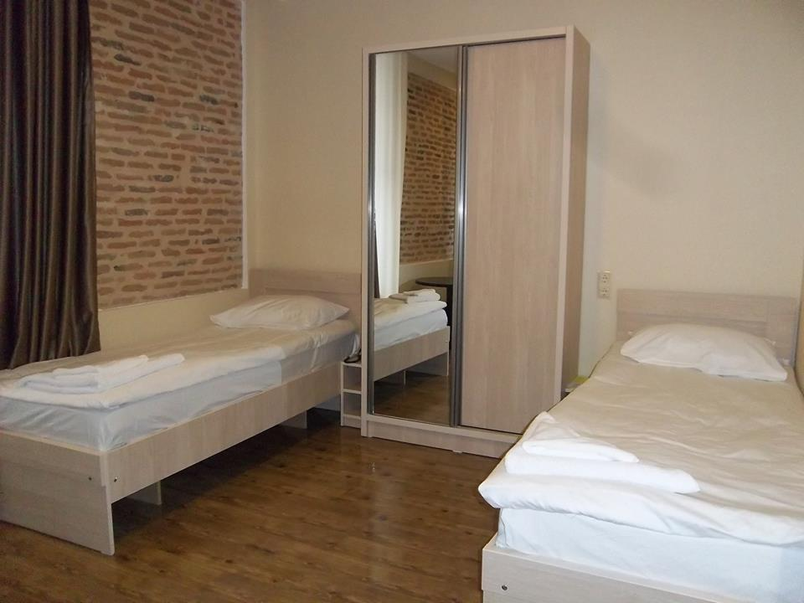
We have various types of rooms :
Single
Double
Twin
Triple

Slide 8
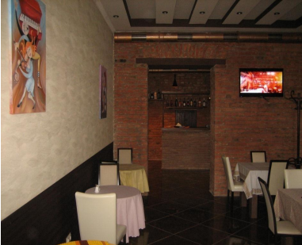
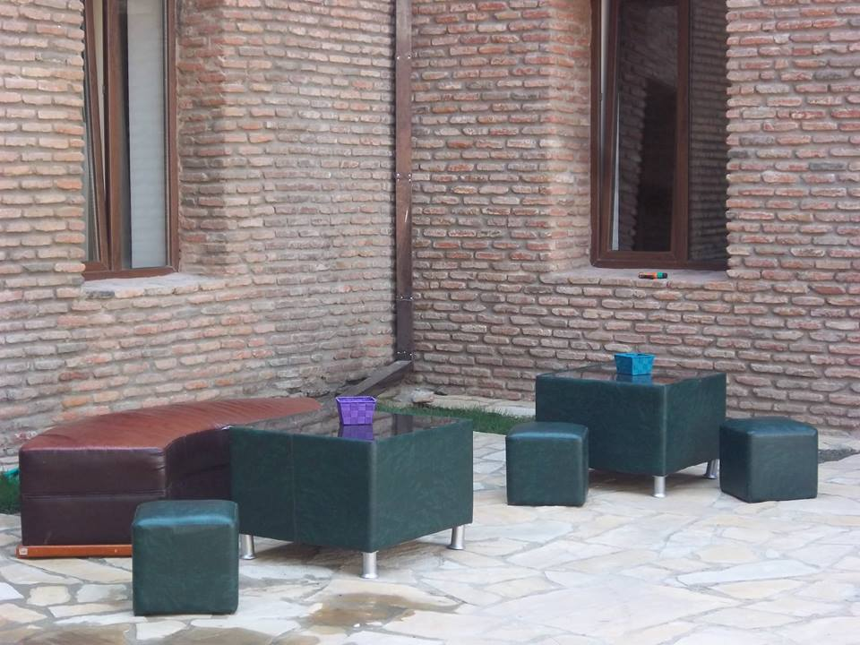
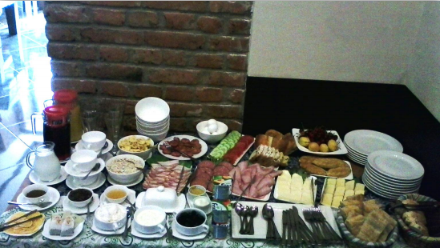
Check out our café/bar
As you know we offer you BB so you can
Have tasty and healthy breakfast every
Morning.
You can also use bar all day long, and we
Can offer you banquets and catering too.

Slide 9
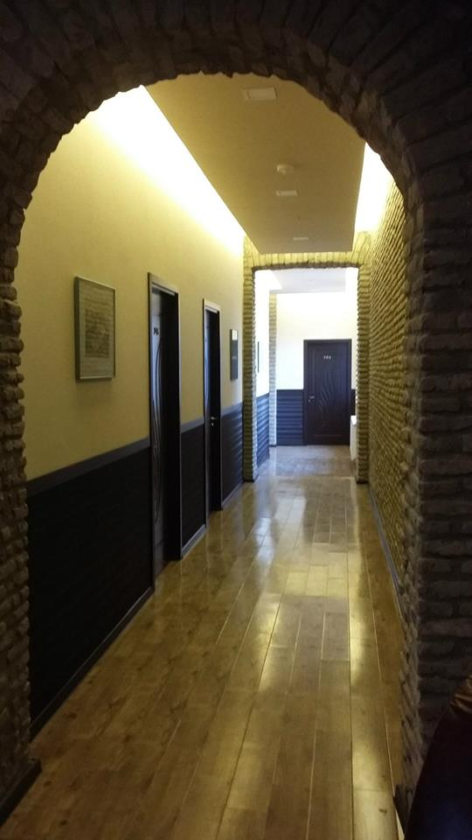
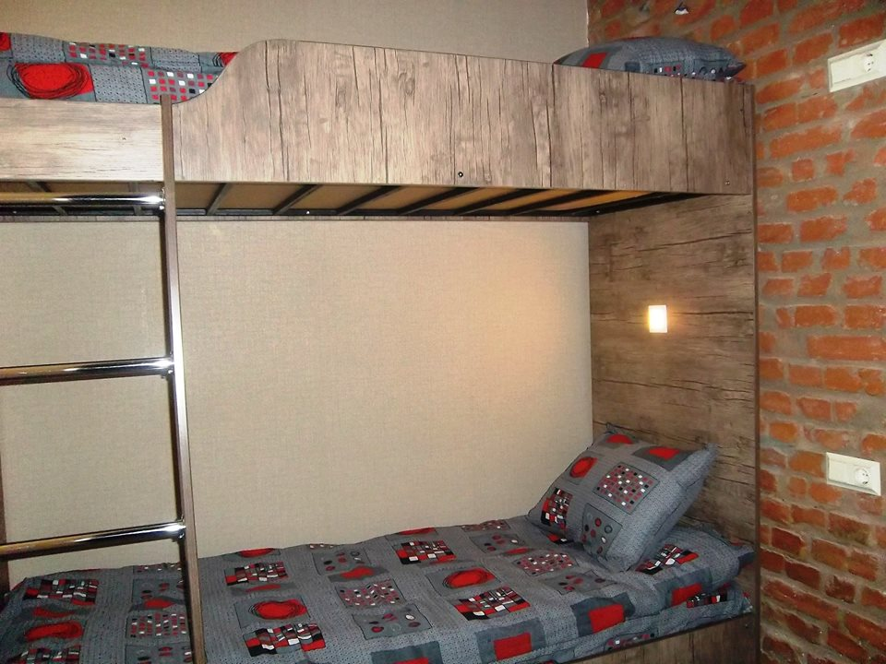
Let’s us have a look at our hostel

Slide 10
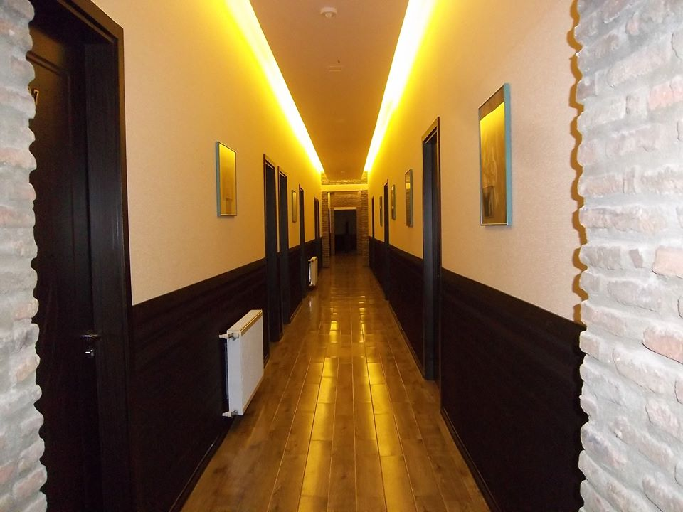
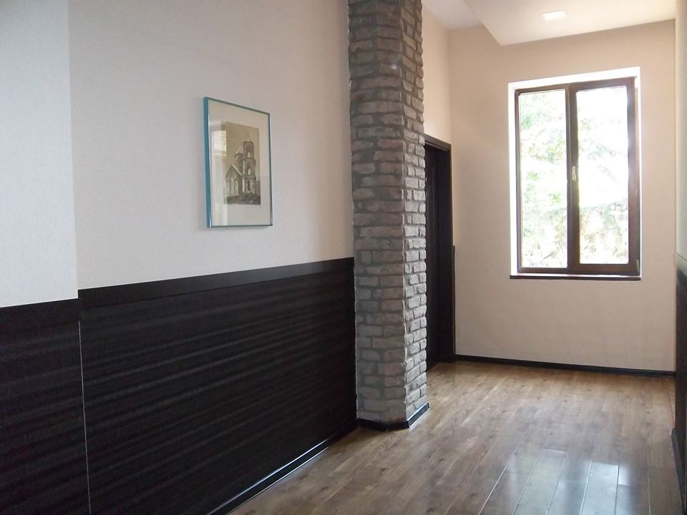
Hall of the Tiflis Hotel/Hostel

Slide 11
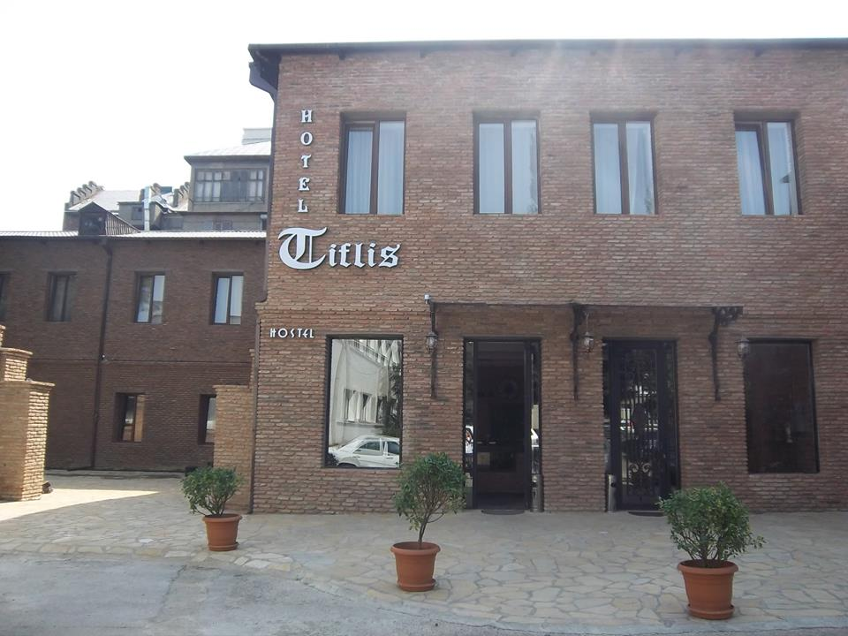
Thanks for Attention
info@hotel-tiflis.com www.hotel-tiflis.com
Hotel "Tiflis" Hostel 25 Marjanishvili str. Tbilisi, Georgia
+995 (32) 2952555 +995 (32) 2955505

